Slide 1
That’s a RAP
Working across teams to develop official statistics, dashboards and accessibility
Laura Dale and Alice Hannah
Notes:
Laura

Slide 2

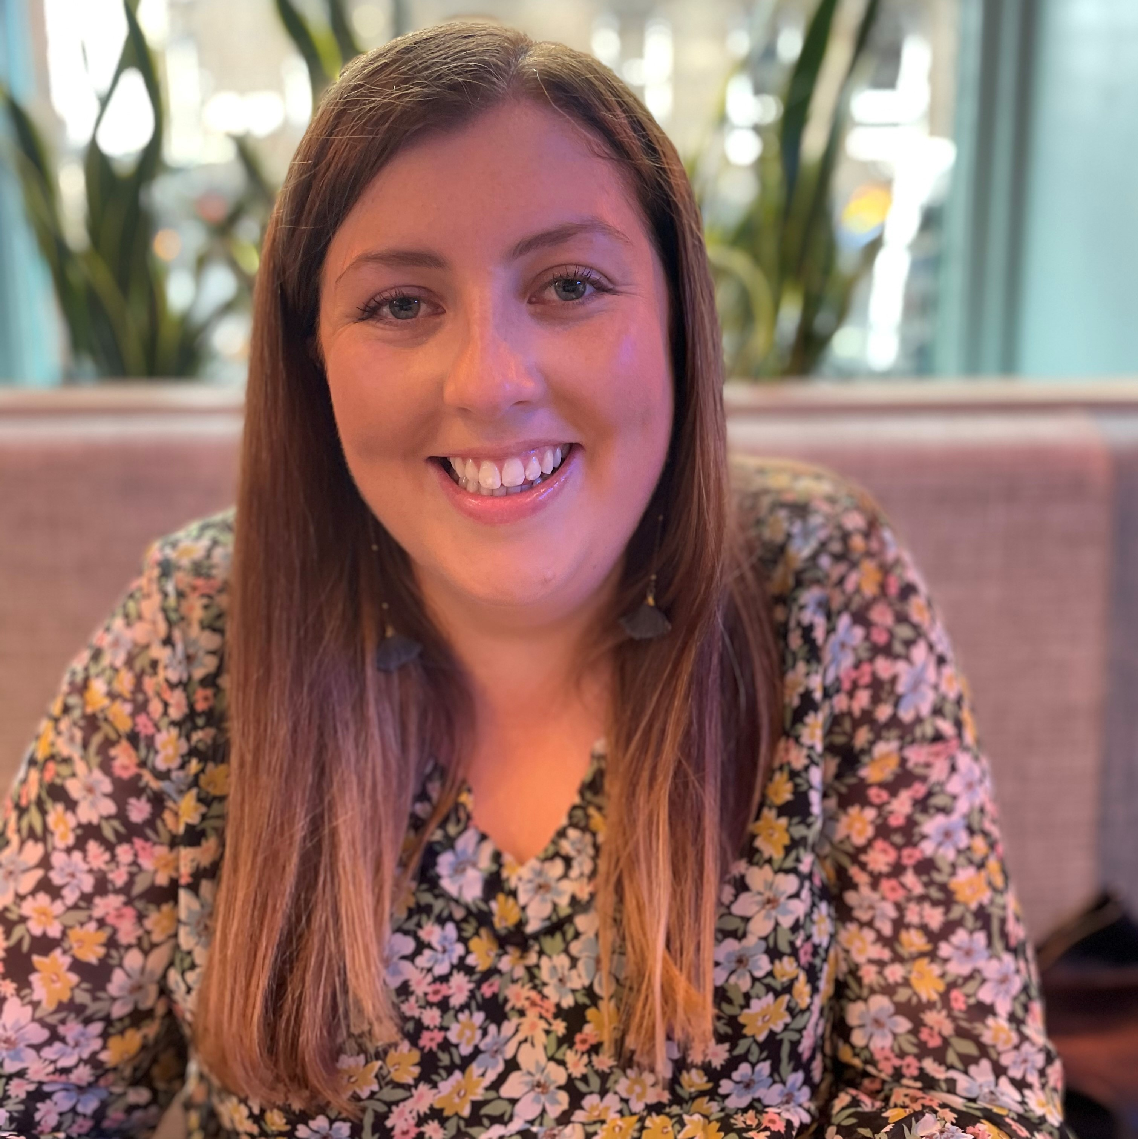
About us
Laura Dale Statistician
Alice Hannah RAP Developer
Notes:
Both

Slide 3
Overview
1
Reproducible Analytical Pipelines (RAP)
2
Accessibility
3
Collaboration
4
Reflections
Notes:
Laura

Slide 4
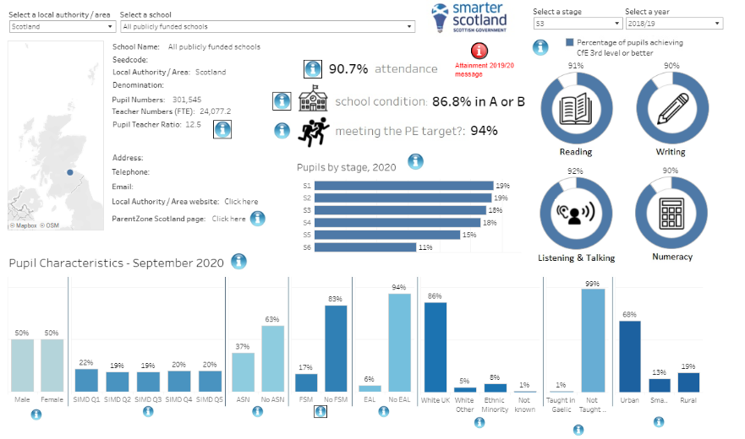
Project example
School information Dashboard (SID)
Roughly 3 weeks with a team of 3 statisticians to create and quality assure.
Prone to errors - a lot of manual data handling in Excel with a lot of data.
Updated twice a year using complex and diverse data formats.
Original platform used: Tableau
Notes:
Laura

Slide 5
Reproducible Analytical Pipelines
1
Notes:
Alice

Slide 6
What is RAP?
Reproducible Analytical Pipelines (RAPs) are automated statistical and analytical processes. They incorporate elements of software engineering best practice to ensure that the pipelines are:
Reproducible
Auditable
Efficient
High quality
Transparent
 | More information Information on RAP on the Government Analysis Function website
Notes:
Alice

Slide 7






RAP Principles
Code written in open-source software with manual steps minimised
Peer reviewed
Version controlled
Open code
Quality assured
Documented
Notes:
Alice

Slide 8
Project example
RAP Improvements
Reviewed processes
No redundant steps
Automated manual steps
Minimised risk of human error
Reduced time taken
Wrote reusable code
Minimised repetition and simplified process
Reduced storage space needed
Version controlled code
Record of how code has changed and why
Published code
Code and methodology available to view or reuse
Notes:
Alice

Slide 9
Accessibility
2
Notes:
Laura

Slide 10
Why is accessibility important?
1
2
3
At least 1 in 5 people in the UK have a long-term illness, impairment or disability. Many more have a temporary disability.
Everybody should be able to access an equal service.
Poor accessibility excludes people.
It’s a legal requirement for public sector bodies.
Notes:
Laura
Estimate how many people using your website might be disabled

Slide 11
RAP and Accessibility
Combining accessibility and RAP principles vastly improves projects and their outcomes
Laura Dale 2024
Notes:
Laura

Slide 12

Project example
Accessibility concerns
Use of tabs
Hover over information
Interactive graphs
Heading order
Information overload
Language level
Notes:
Laura

Slide 13
Collaboration
3
Notes:
Alice

Slide 14
RAP Support for Analysts
In the Scottish Government, the Data Division provides RAP support to analysts in the following areas:
Project planning and structure
Coding in
open-source software
Using Git and GitHub
Code reviews
Notes:
Alice

Slide 15
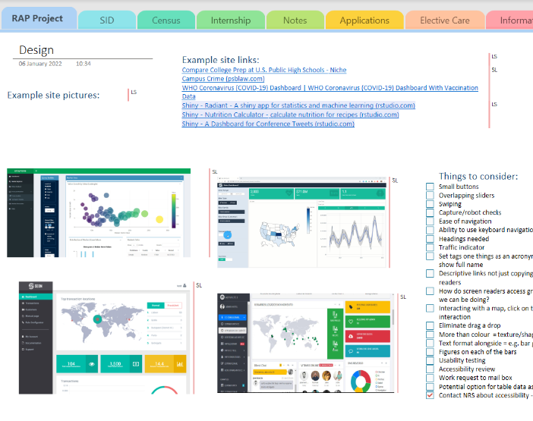
Project example
Useful tools
GitHub
OneNote
Pair programming via MS Teams
Online and in person meetings
Notes:
Both

Slide 16
Reflections
4
Notes:
Laura

Slide 17
What went well
1
2
3
Improved quality of statistics:
Accessibility
Usability
Consistency
Reliability
Reduced errors and the time taken to produce and update the dashboards.
Shared knowledge and learned new skills.
Connections made across SG teams.
Notes:
Laura

Slide 18
Lessons Learned
1
2
3
It’ll take longer than you expect.
A good plan is a flexible plan.
It doesn’t need to be perfect to be good enough.
Too many cooks can be a problem, but so can too few.
Notes:
Alice

Slide 19
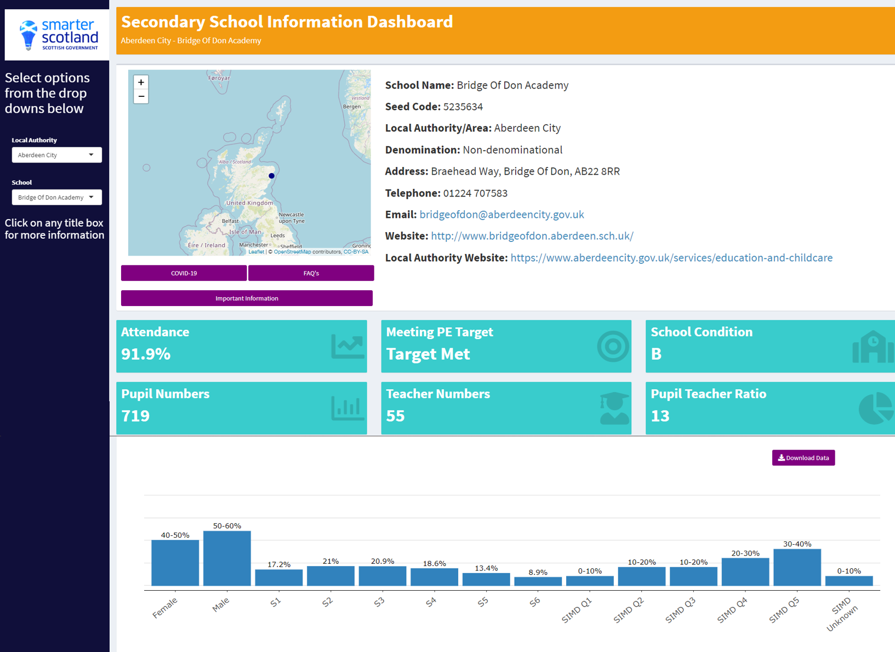
Project example
Improvements
RAP
Updated in hours, instead of days
Fewer errors
Code shared on GitHub
Accessibility
No tabs
Downloadable data
Headings ordered correctly
Reduced information on page
Notes:
Alice – RAP
Laura - Accessibility

Slide 20
Contact us
Laura Dale
Statistician
Alice Hannah
RAP Developer
laura.dale@gov.scot
github.com/Laura-Dale
alice.hannah@gov.scot
github.com/alice-hannah

Slide 21
Links & Resources
School Information Dashboards: Shiny dashboard and GitHub repository
RAP
Accessibility
Government Analysis Function RAP Guidance
Blog: Reproducible Analytical Pipelines: How we saved 3 analysts 6 weeks of copying and pasting
Front-End Checklist
Hemingway Editor
Colour Brewer
Estimate how many people using your website might be disabled

Slide 22

“That’s a RAP”
© Open Government Licence | Template v1.0

